Slide 1


Chef’s Big Book of Power BI Recipes
How to cook and serve delicious Power BI “meals” Nikola Ilic

Slide 2

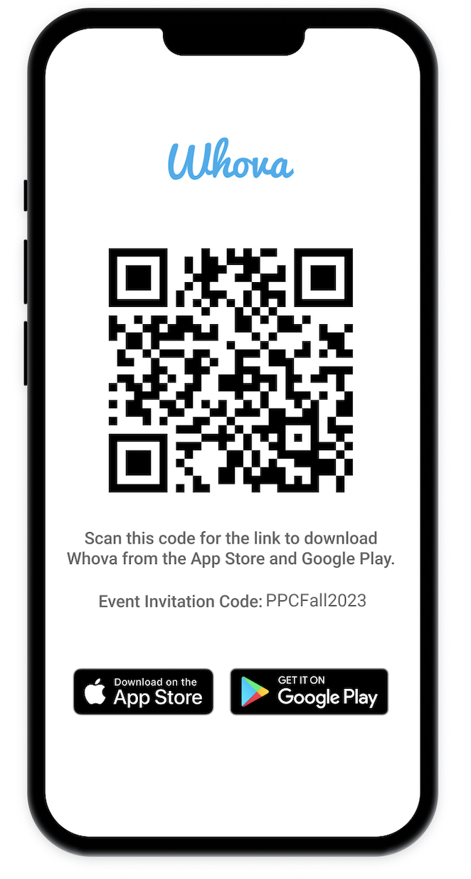
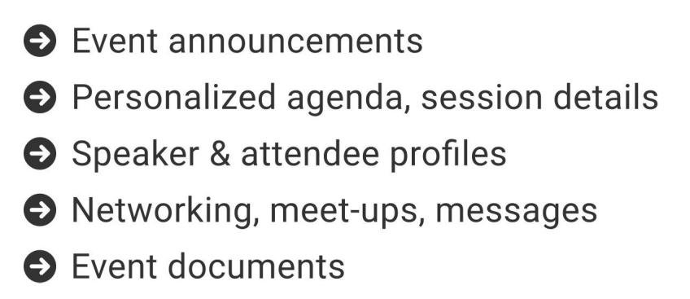
The official event app for the Microsoft Power Platform Conference – Fall 2023
Join the event app to access:
Event Invitation Code: PPCFall2023

Slide 3
Chef’s Big Book of Power BI Recipes!
How to cook and serve delicious Power BI “meals”
Nikola Ilic

Slide 4




Nikola Ilic
Consultant & Trainer
data-mozart.com
@DataMozart
learn.data-mozart.com
I'm making music from the data!
Power BI and SQL addict, blogger, speaker...
Father of 2, Barca & Leo Messi fan...

Slide 5


Menu
Data Modeling Main Courses
Data Visualization Desserts
Animated Tooltip ice cream
Storage mode soup
Accessibility hot chocolate
Bi-directional spaghetti
Bookmarks with vanilla
Steak filled with BLANKs
Field parameters creamy cake
Field parameters with mushrooms
Personalize visuals Apple Pie

Slide 6
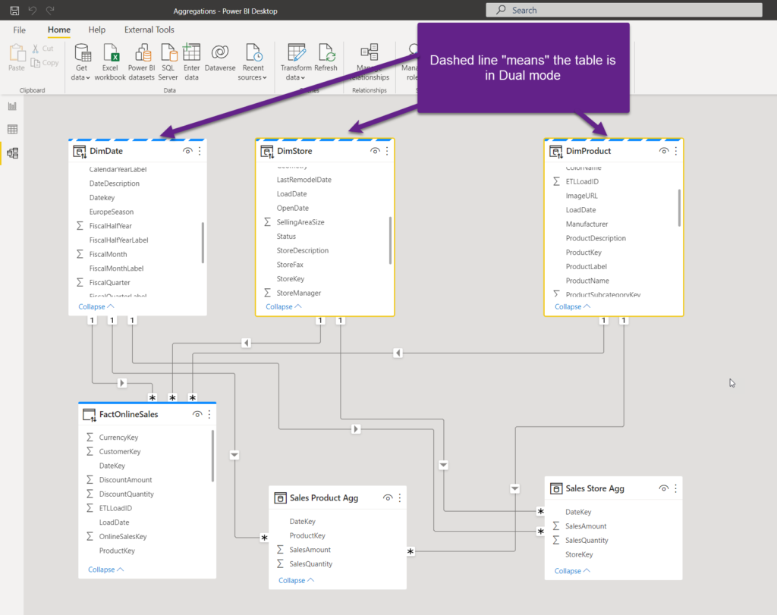
Storage Mode Soup
Always use Import mode – unless you have a valid reason not to!
DirectQuery in 3 scenarios
Extremely large dataset
Real-time reporting requirements
Security rules applied on the data source
Dual for dimension tables in composite models
Hybrid – best of both worlds!
Direct Lake – best of “all” worlds!

Slide 7
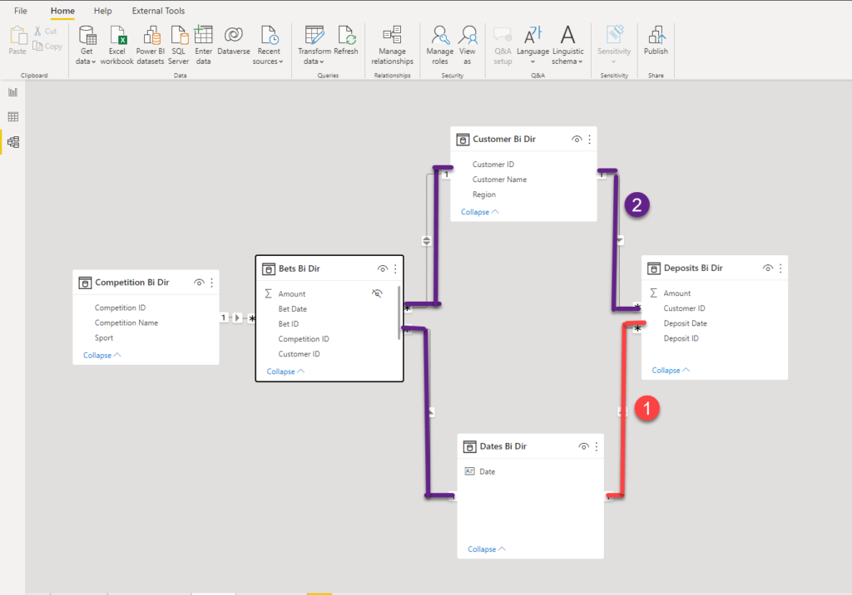
Bi-directional Spaghetti
Can slow down performance
Can cause INCORRECT results!
Slicer values “with data”
Dim-to-Dim analysis

Slide 8
Steak Filled with BLANKs
Replace BLANK with explicit value (usually 0)
Use COALESCE, IF…
Think twice before you eat that!

Slide 9
Field Parameters with Mushrooms
Dark ages of Power BI
“Exotic” DAX with TREATAS
SWITCH like a pro
Solve some of the most common requirements in an easy way

Slide 10
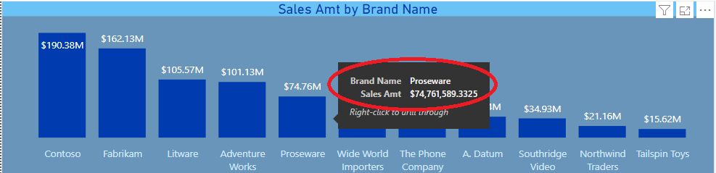
Animated Tooltip Ice Cream
Default options are sometimes not enough attractive
Tooltip pages are a powerful way of communicating information
Bonus Tip – create a fully animated Tooltip page!

Slide 11






Accessibility Hot Chocolate
Same Power BI report looks different on different devices

Slide 12


Why Accessibility Matters?
No visual impairments
Green-Blind (Deuteranopia)

Slide 13
Accessibility Features
BUILT-IN
CONFIGURABLE
Keyboard navigation
Screen reader
High contrast color
Focus mode
Show data table
Alt text
Tab order
Labels & Titles
Markers
Themes, contrast, colors

Slide 14
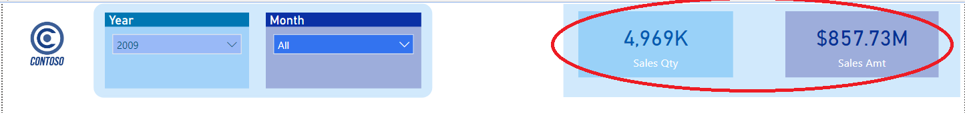
Bookmarks with Vanilla
Out-of-the-box solutions sometimes are not enough
By default static visuals, can become dynamic
Little tweakings sometimes bring great benefits!
Be careful with usage – don‘t create an overhead instead of functionality!

Slide 15

Field Parameters Creamy Cake

Slide 16

Personalize Visuals Apple Pie
Hm…I want this to be a line chart
What’s wrong with having a column chart?
Report consumers can customize the visual according to their needs

Slide 17
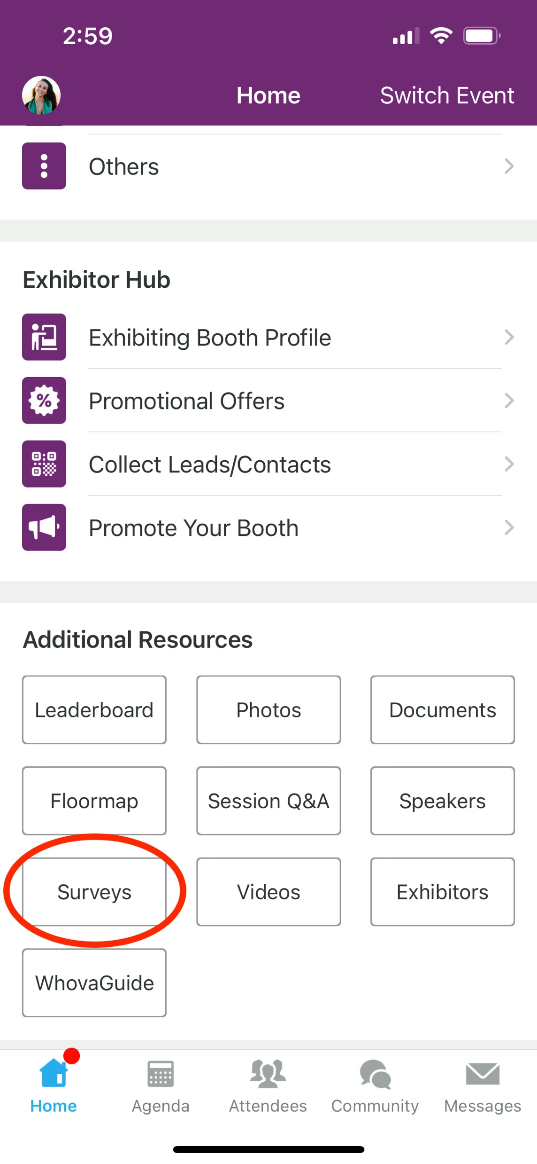
Session Feedback Surveys
We really want to hear from YOU!
In the pursuit of making next year’s Microsoft Power Platform Conference even better, we want to hear your feedback about this session.
Here’s How -
Simply go to the Whova App on your smartphone
Scroll down on the Microsoft Power Platform Conference Homepage to ‘Additional Resources’ to click “Surveys’.
Click Session Feedback.
Scroll down to find this session title.
Complete the session feedback survey.
Finally, click ‘Submit’
It’s just that easy!

Slide 18
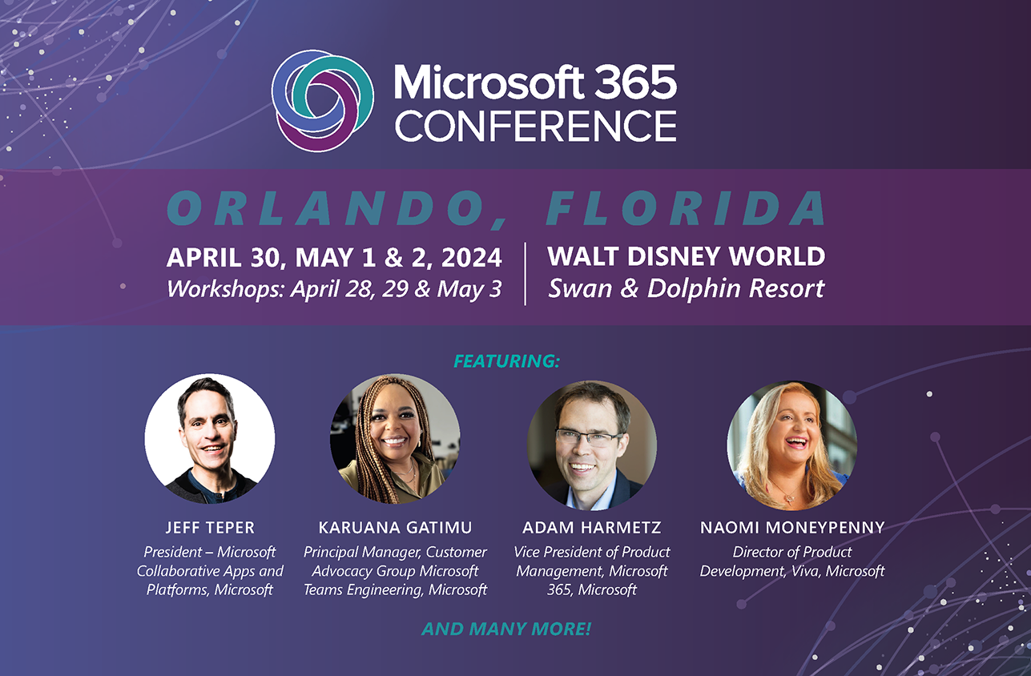

Slide 19


Slide 20
Thank you
data-mozart.com
@DataMozart
learn.data-mozart.com

